Slide 1

Exploratory Data Analysis of
Dataset
Rajkumar Kanagasabai
Gnaneeswar Adhi

Slide 2

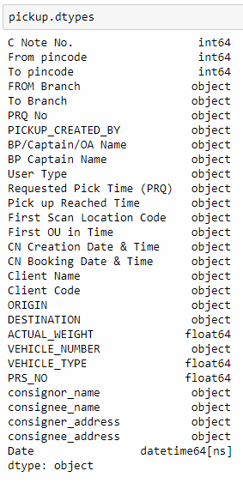
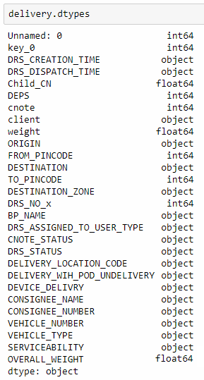
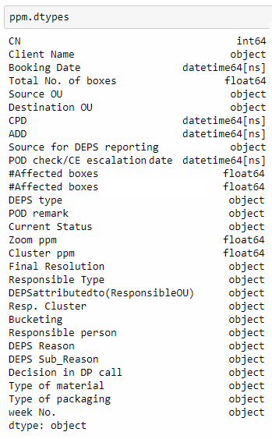
Data Sheet

Slide 3
Data Dictionary
VARIABLE | VARIABLE DESCRIPTION
Consignment number | Unique Consignment tracking number. Serves as the Primary Key
Actual Weight | Weight of each consignment
From Pincode and Branch | Pincode / Branch of origination of the consignment
To Pincode and Branch | Pincode / Branch of destination of the consignment
Client, Consignee Name | Client is the consignor and consignee is the recipient of the consignment
DEPS Type | Damage / Excess / Pilferage / Shortage
Bucketing | Segment of Transportation in which a specific DEPS occured
DRS Creation Drs Dispatch Time | Time at which the delivery is planned. Time at vehicle dispatch for delivery Difference between these two is DRS Loading Time
VARIABLE | VARIABLE DESCRIPTION
Vehicle Type, Vehicle Number | Type and reg.no of vehicle used for In_Transit Transportation
PRS , DRS | Pickup Run Sheet, Delivery Run Sheet
PRS Number | Unique Number assigned to a bundle of consignments alloted to a specific vehicle
Operating Unit | The place where the packages are handled. [Warehouse]
First Mile, In Transit, Last Mile | Client to OU is First Mile, OU to another OU is In Transit, Ou to Consignee is Last Mile
Business Partner | First and Last Mile Transport is outsourced to sub-contractors
BP Captain Name | Name of Business Partner Captain (Driver Executive).
PRQ Time, Pickup Reached Time, OU in Time | Pickup time requested by client, actual pickup time, time when consignment reached OU

Slide 4
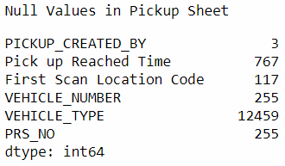
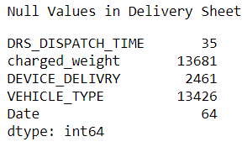
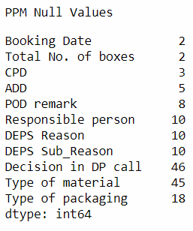
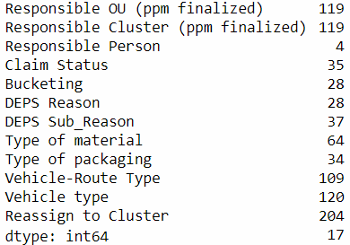
Null Values
Null Values in PPM Sheet

Slide 5
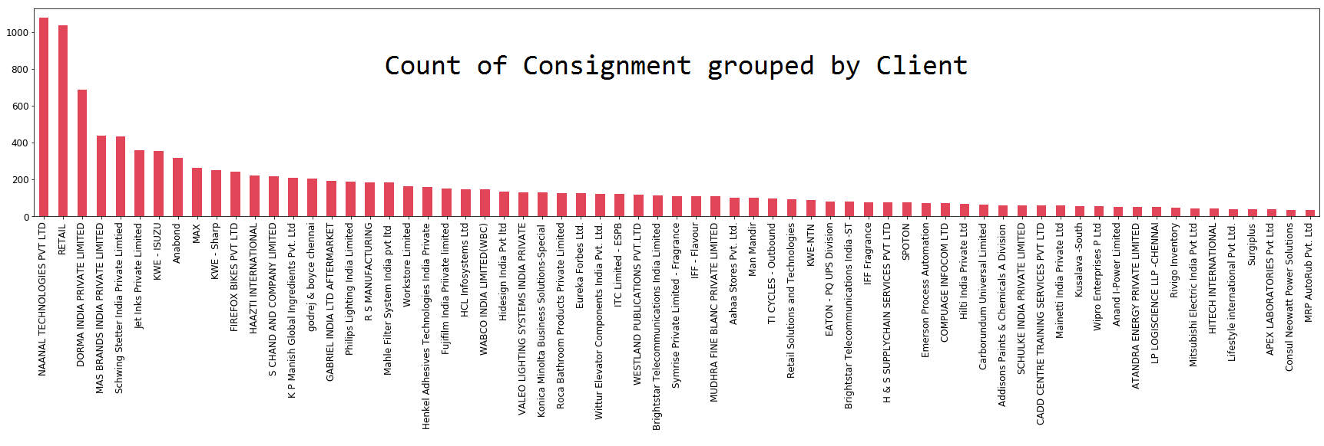
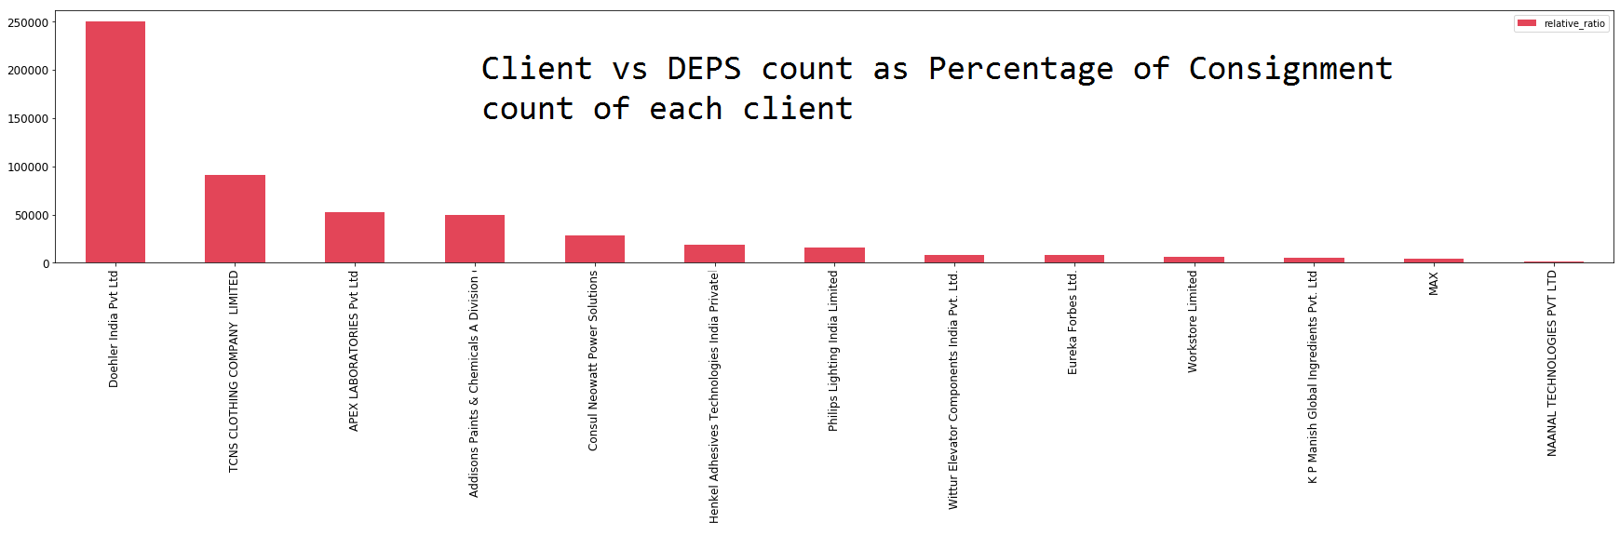
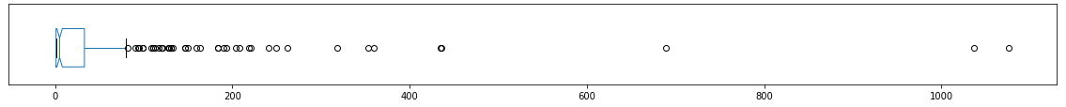
Plots

Slide 6
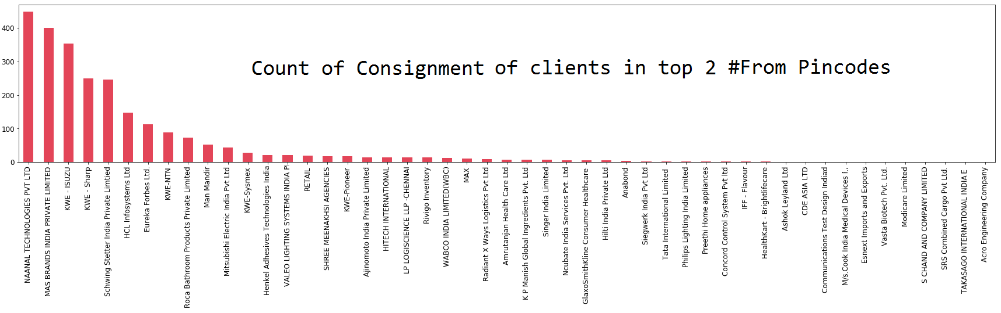
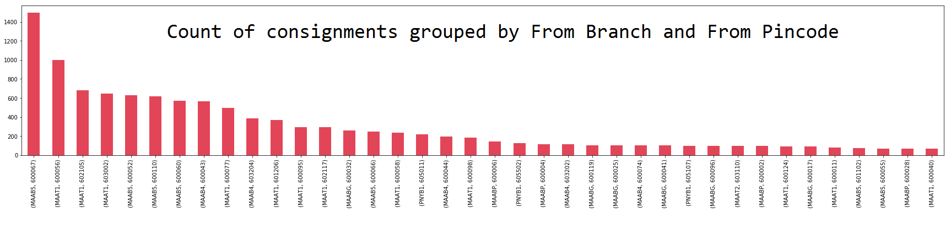
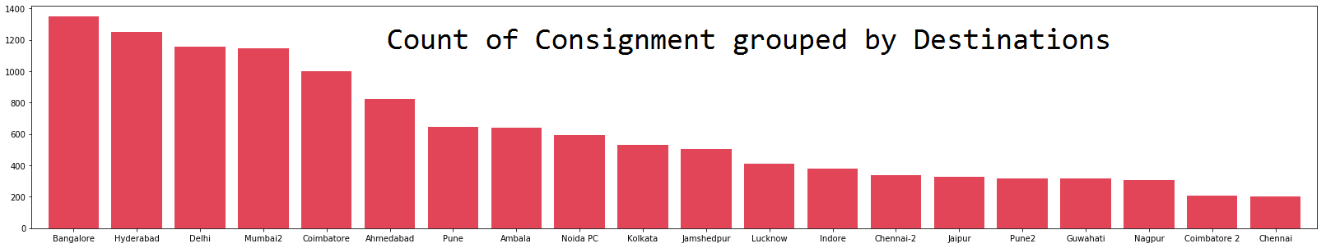

Slide 7
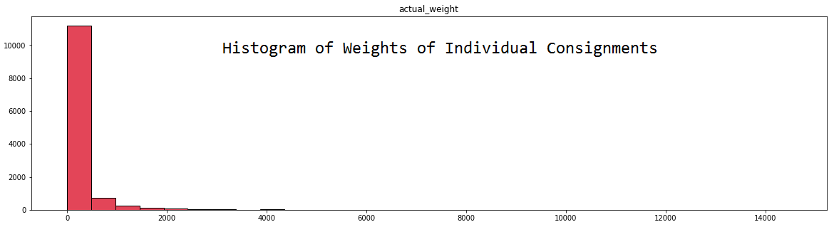
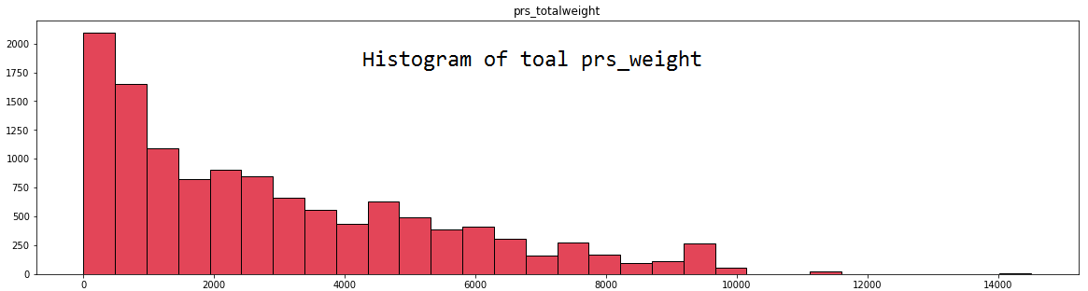

Slide 8
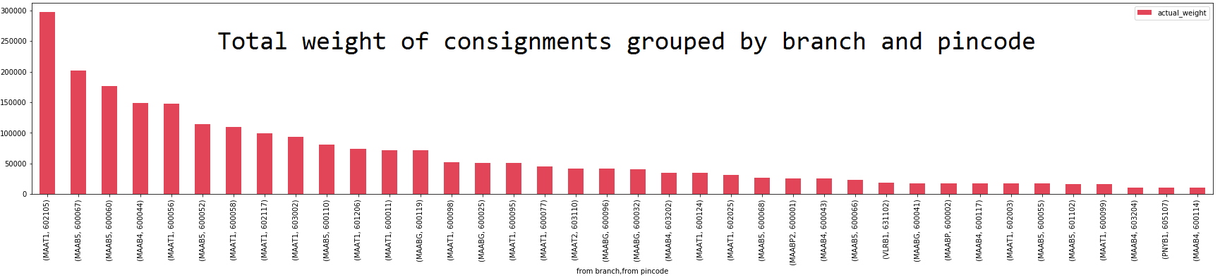
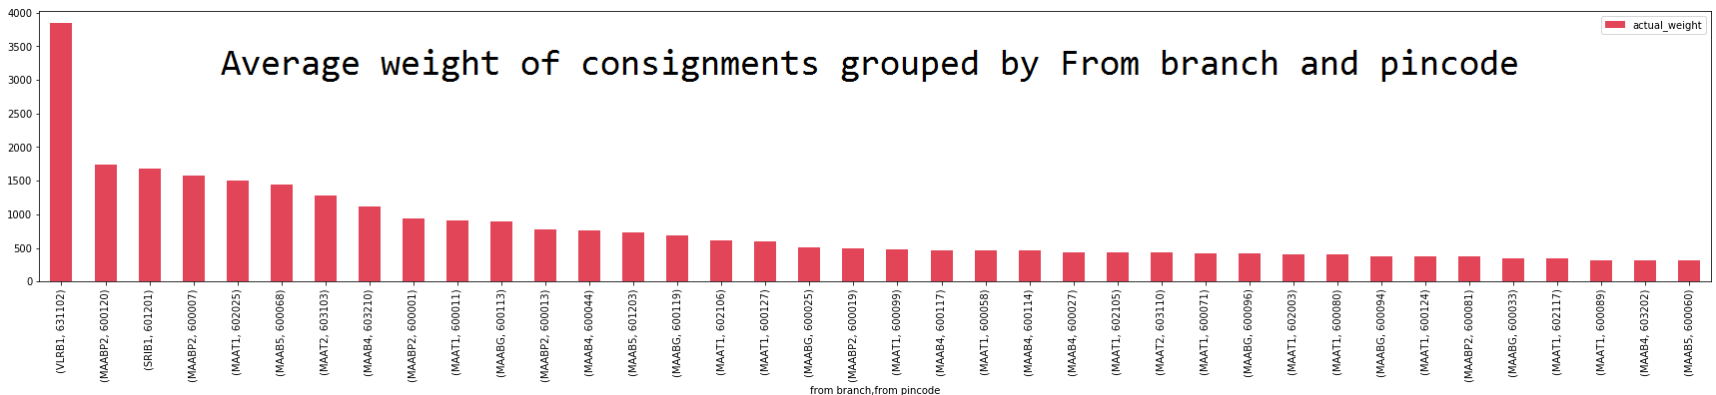
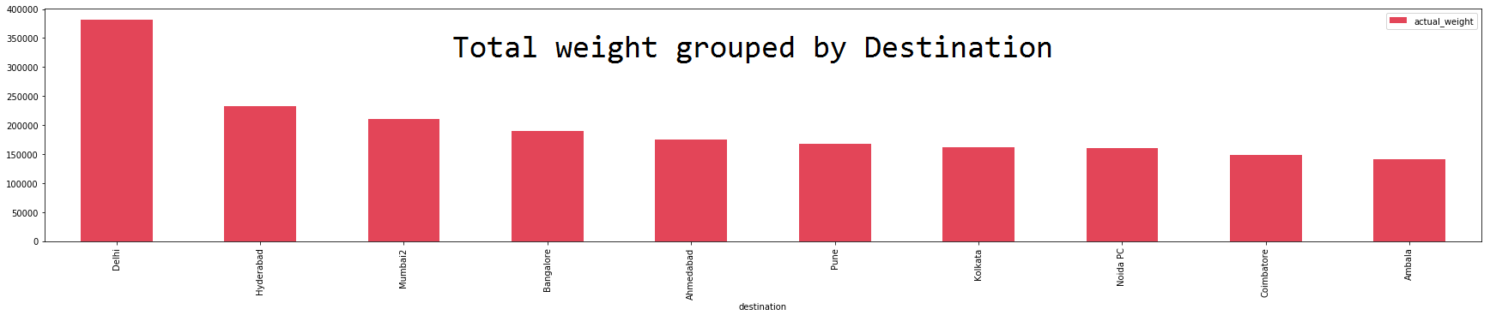
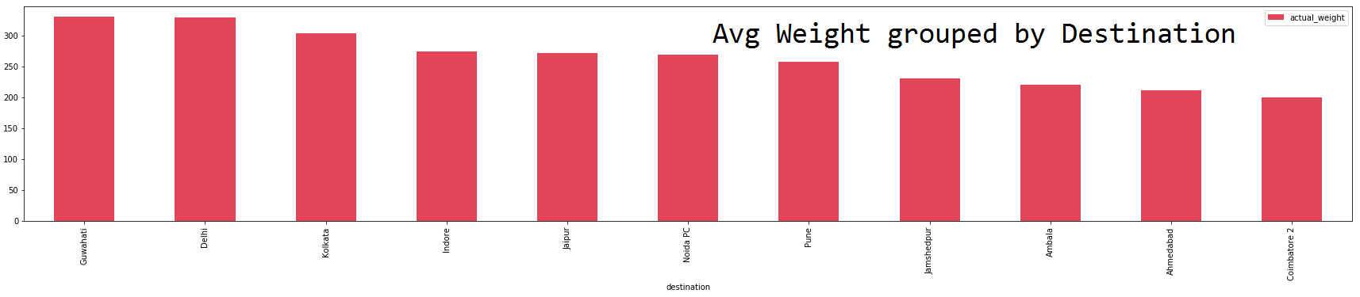

Slide 9
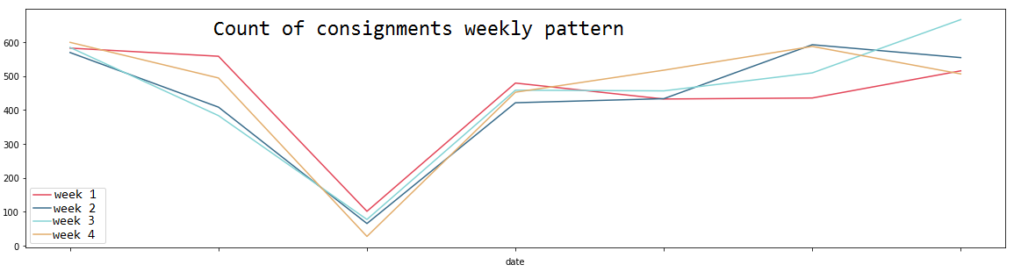
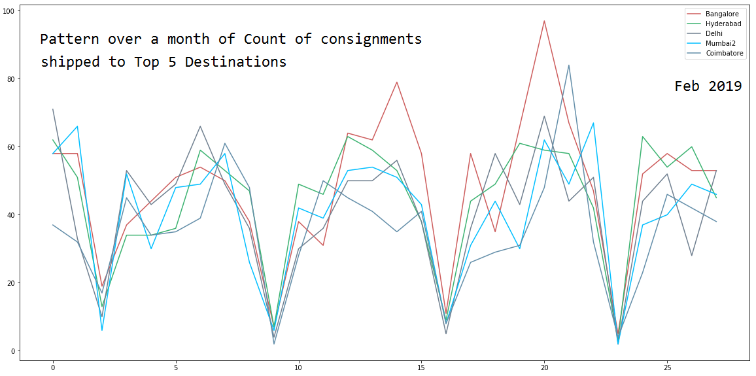

Slide 10
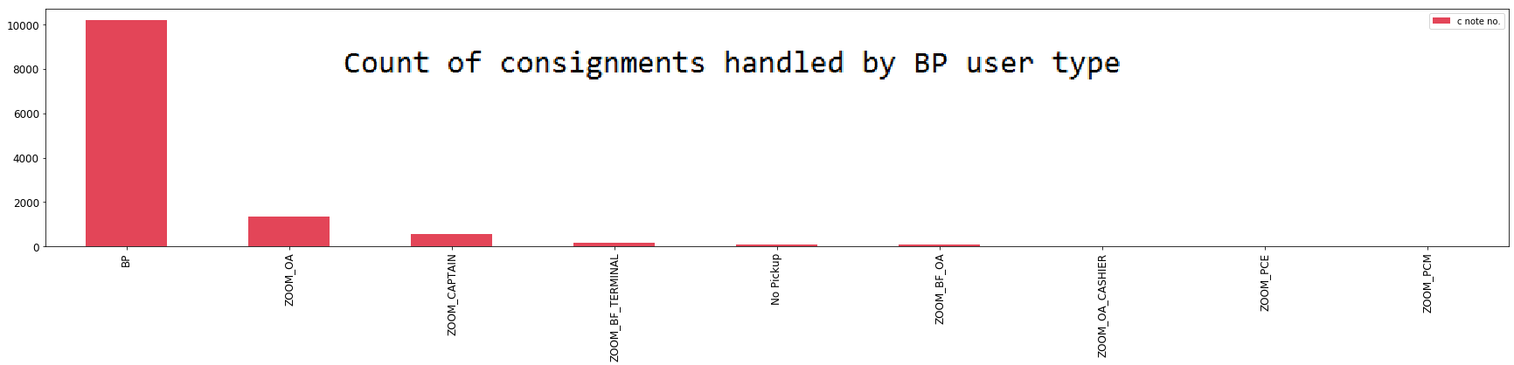
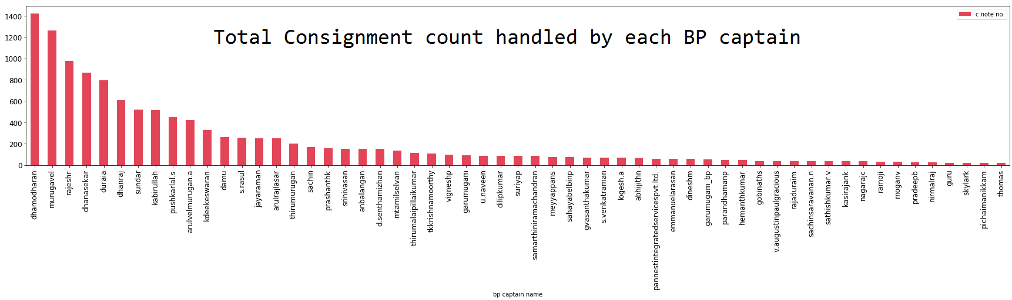
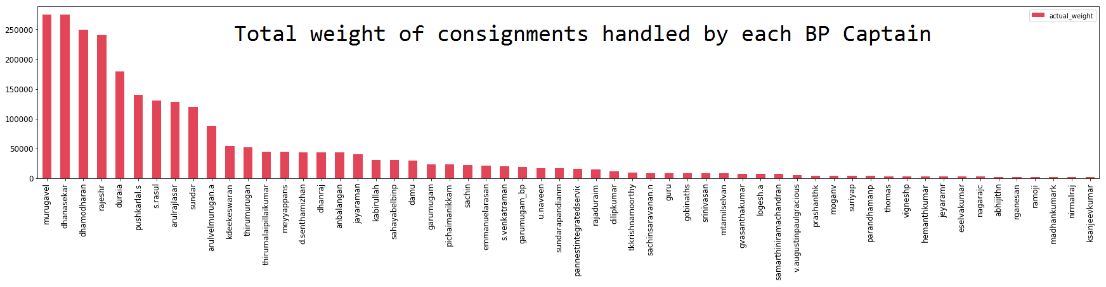
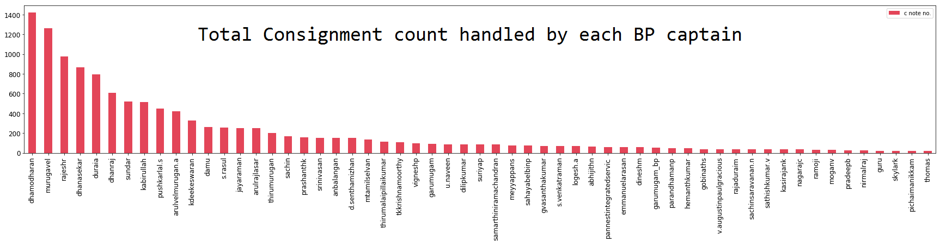

Slide 11
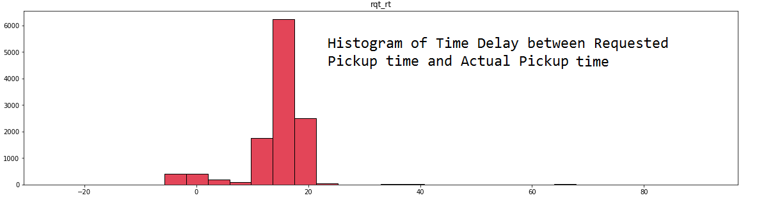
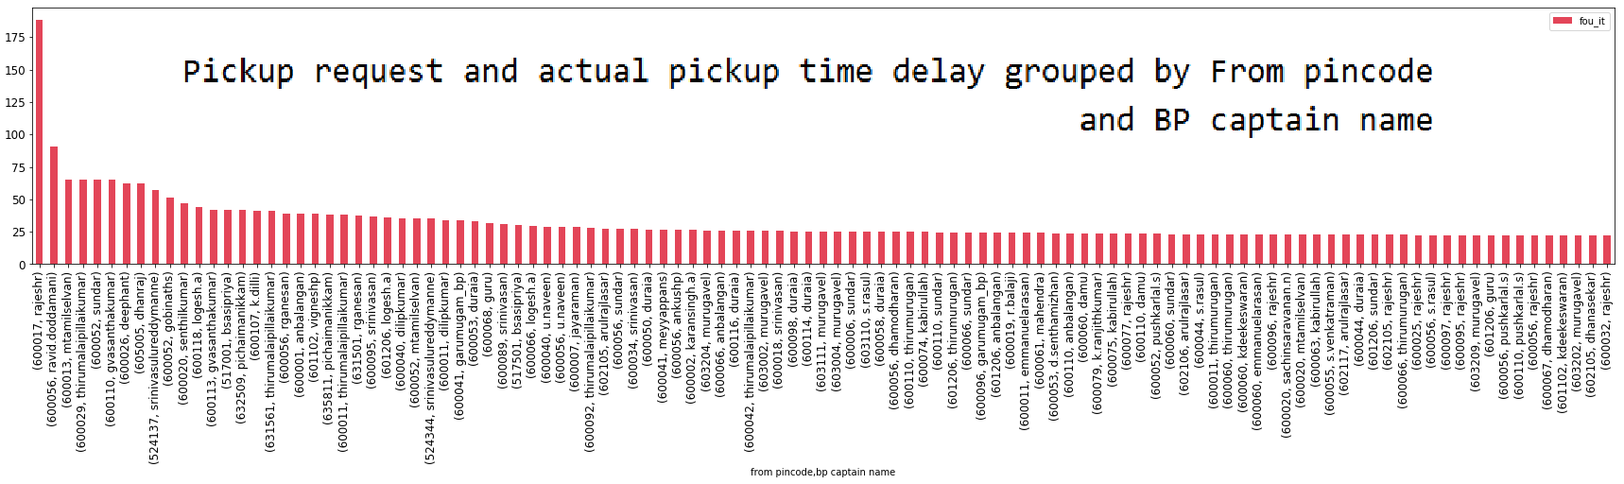

Slide 12
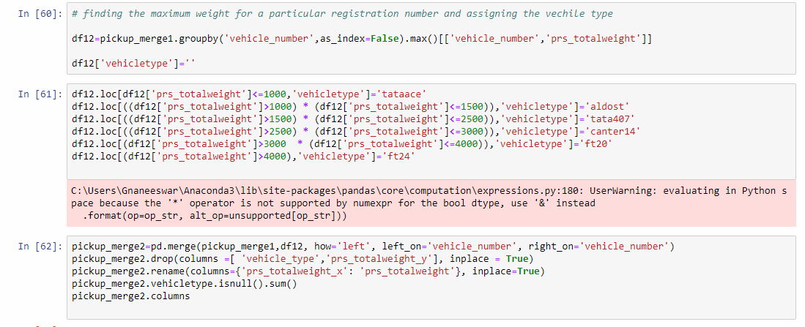
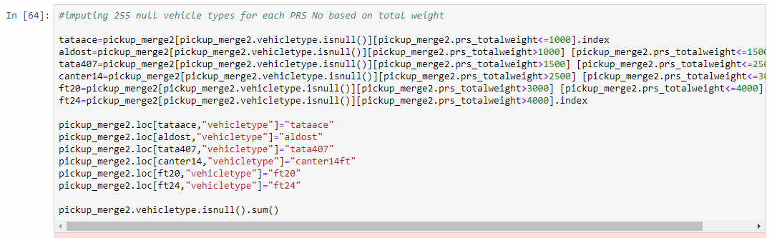
Missing Value Imputation of Vehicle Type using
Deductive Logic

Slide 13
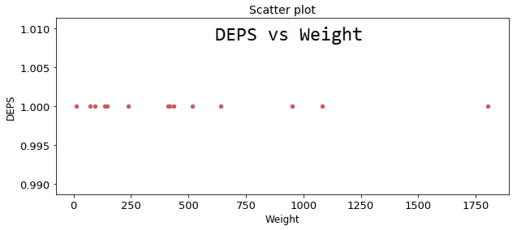
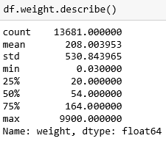
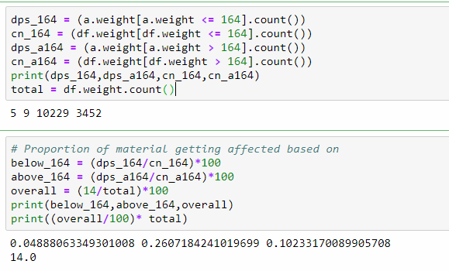
How is Deps related to Other Variables
DEPS vs Consignment Weight
Visually observing the scatter plot we see that 50 % of material affected by deps are in the weight range of 138 to 609 .
In other words the proportion of consignment getting damaged will be higher when its weight is above 164 kg and vice-versa

Slide 14
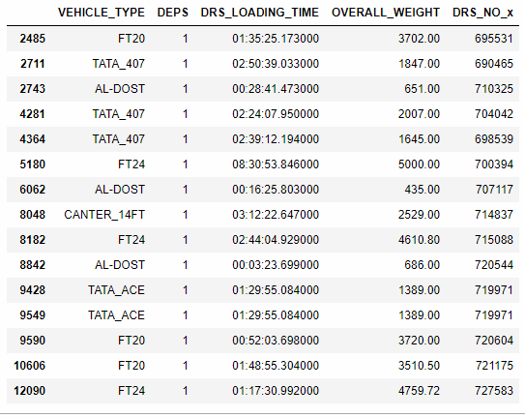
How is Deps related to Other Variables
From the table we can conclude that the relationship between DRS_LOADING_TIME and occurrence of DEPS is based on VEHICLE_TYPE
There is a chance for DEPS to happen if the DRS_WEIGHT and loading_time takes a range as per the table shown

Slide 15
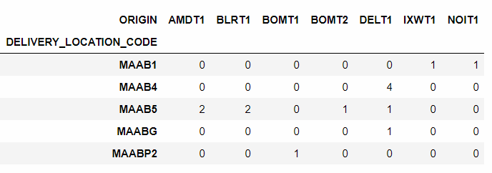
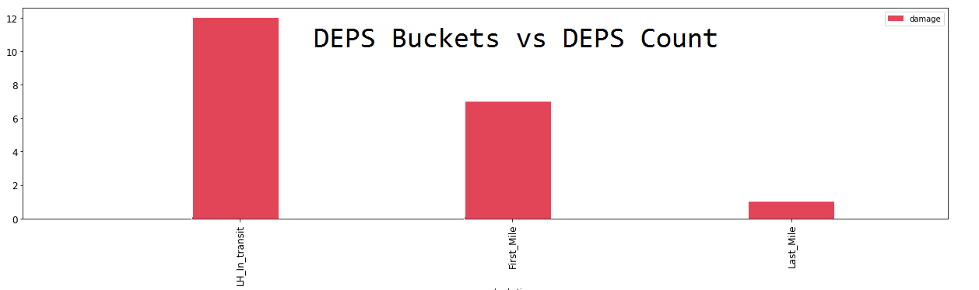
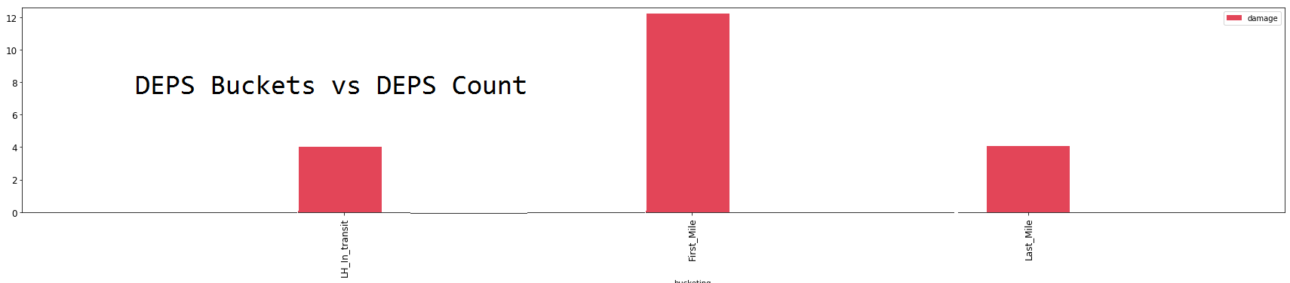
How is Deps related to Other Variables
These are Routes where DEPS occured as per the data.
There is relationship between DEPS and route because DEPS occurs only in the above 9 routes
Deps Buckets vs Deps Count Pickup sheet
Deps Buckets vs Deps count Delivery Sheet

Slide 16
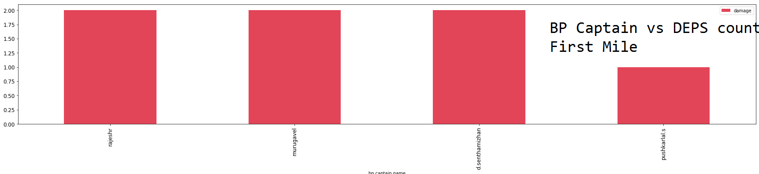
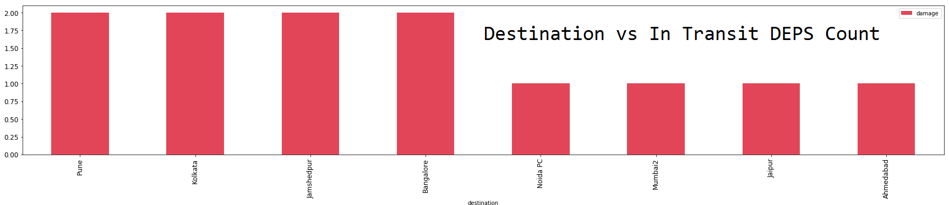
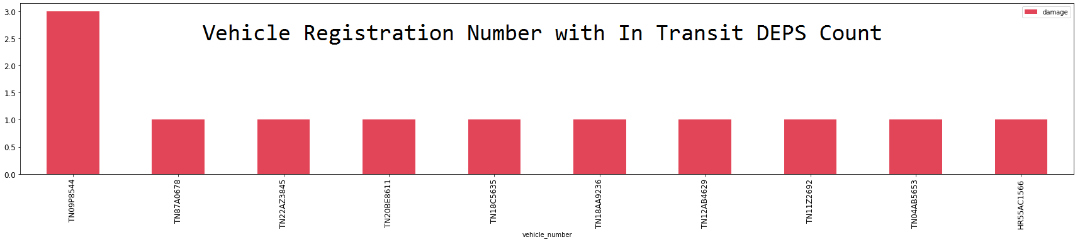
How is Deps related to Other Variables

Slide 17
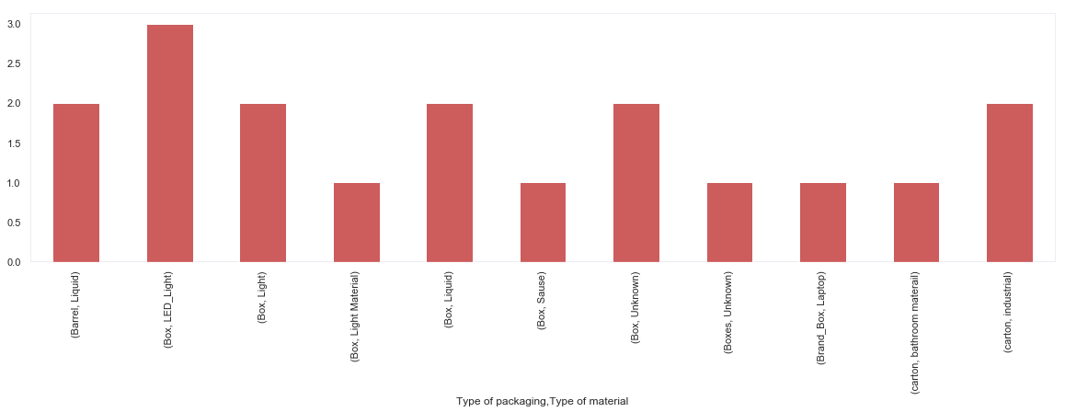
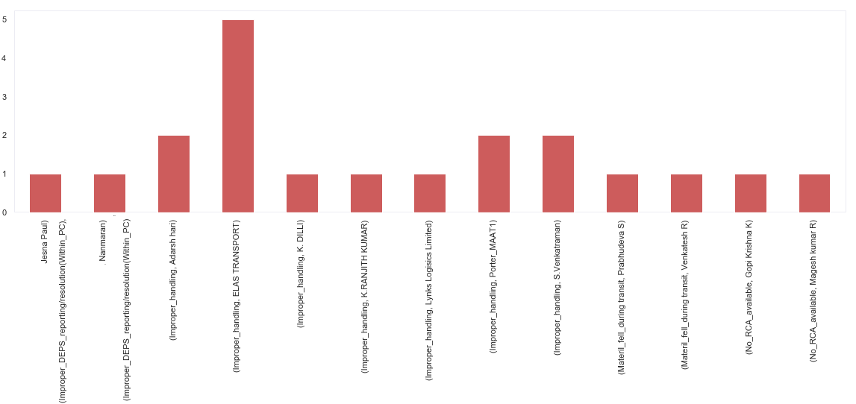
Deps Count grouped by Packaging and Material
Deps Count grouped by subreason and OA name

Slide 18
1. Nanaal Technologies is the client with highest count of consignments. But one with the least Deps ppm.
2. Consignments of Client Diachler India has the highest DEPS ppm.
3. Pincodes 60067 has the highest consignment count but with zero DEPS
4. Delhi has the highest count of consignees
5. Materials above 164 kg are likely to get damaged more than material under 164 kg
6.. There is chance for relationship between the routes and DEPS as the event DEPS occurs only in the above 9 routes(to conclude it we need see the previous months data )
7.. There is chance for relationship between the BP_NAME and DEPS
8.. There is a relationship between the DRS_Overall weight and the Vehicle type used
9. There is a relationship between the BP_NAME and DELIVERY_LOCATION_CODE
10. There is relationship between Consignment weight and DEPS
Inferences from Analysis

Slide 19
Questions ?

